Slide 1
Introduction to Robotics
CSE 461
Lecture 6: Forward Kinematics
Md Toki Tahmid
Lecturer, Dept. of Computer Science and Engineering
Brac University

Slide 2
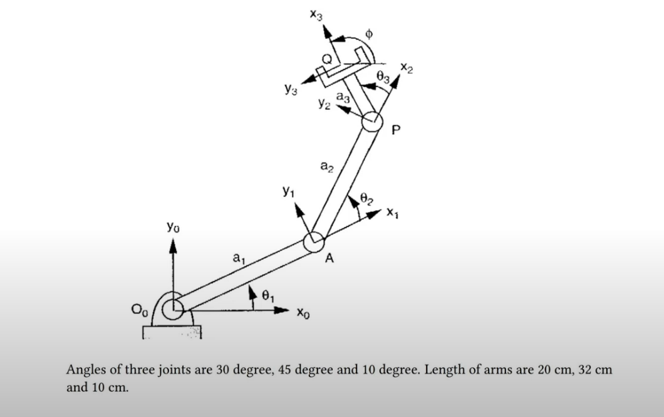

Slide 3
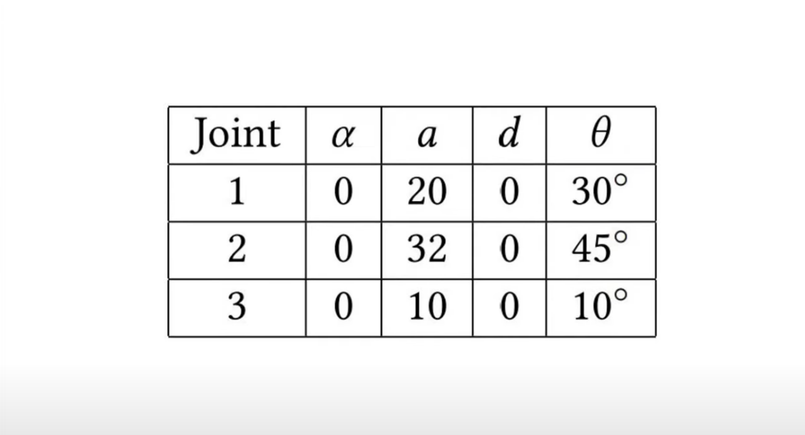

Slide 4
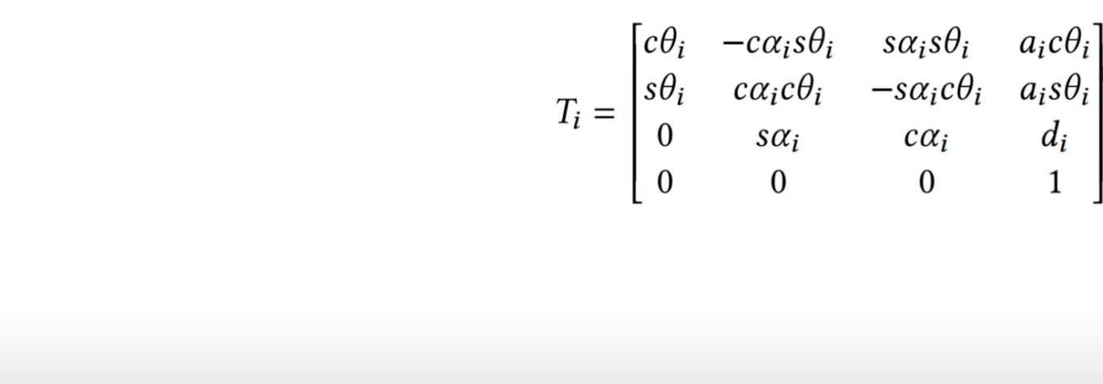

Slide 5

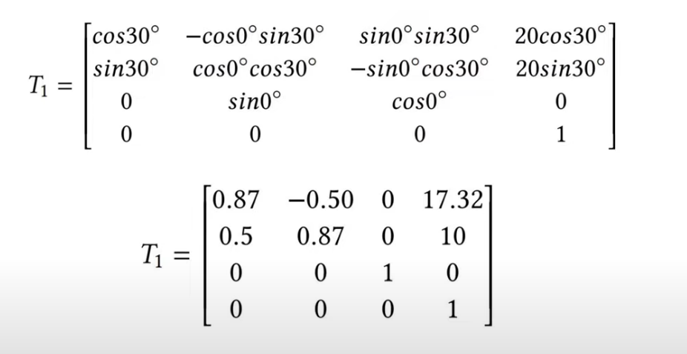

Slide 6

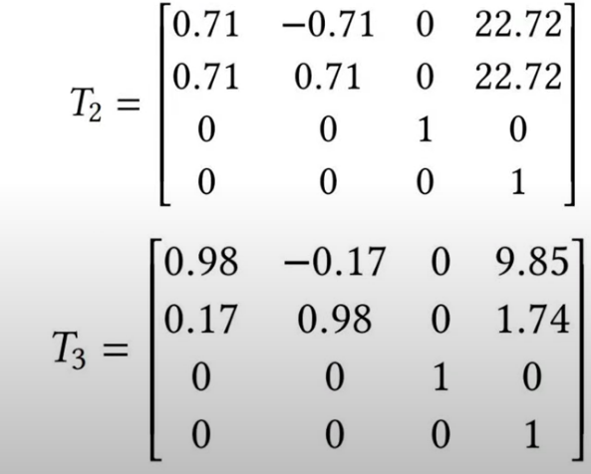

Slide 7



